Slide 1


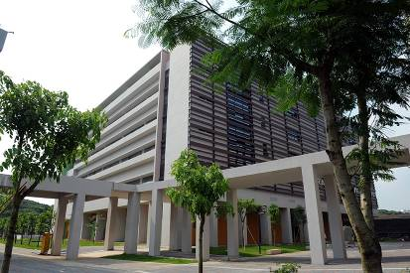
Engineering Electromagnetics 工程电磁场
Youwei Jia 嘉有为

Slide 2

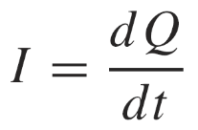
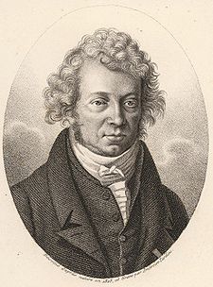
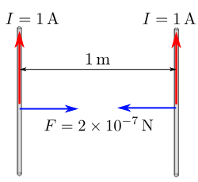

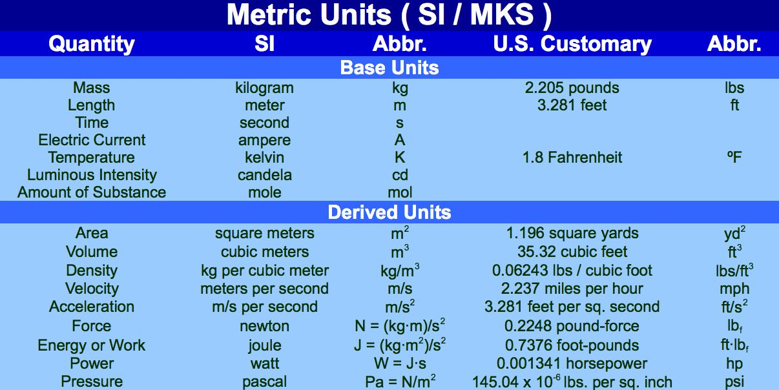

9: Conductors & Dielectrics
Current and Current Density 电流和电流密度
Current is a flux quantity and is defined as:
Current is defined as the motion of positive charges.
The unit of current is the ampere (A), and Current is a scalar.
Ampere is one of the seven SI unit symbol.
The constant current that will produce an attractive force of 2×10^{–7} newton per meter of length between two straight, parallel conductors of infinite length and negligible circular cross section placed one meter apart in a vacuum
André-Marie Ampère
(1775-1836)
国际计量局
Meter Convention 米制公约
1

Slide 3
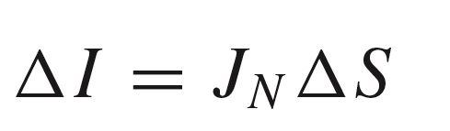

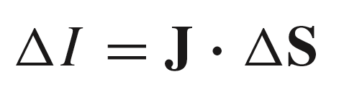

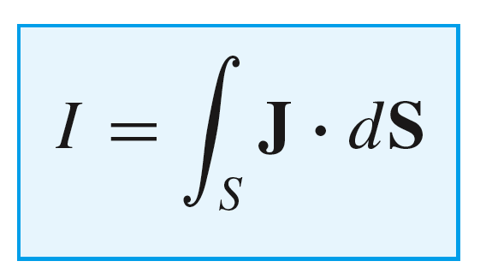

9: Conductors & Dielectrics
Current and Current Density 电流和电流密度
Current density, J, measured in A/m² , yields current in Amps when it is integrated over a cross-sectional area. The assumption would be that the direction of J is normal to the surface, and so we would write:
In reality, the direction of current flow may not be normal to the surface in question, so we treat current density as a vector, and write the incremental flux through the small surface in the usual way:
where ΔS = n da
n
Then, the current through a large surface
is found through the flux integral:
2

Slide 4
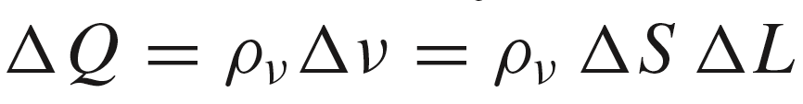
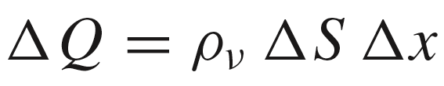
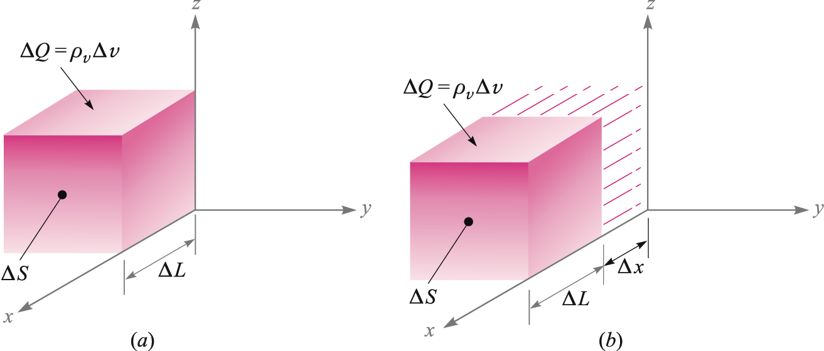
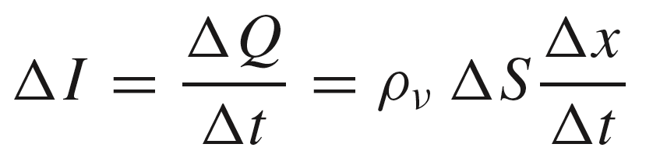

9: Conductors & Dielectrics
Relation of Current to Charge Velocity
Consider a charge ΔQ, occupying volume Δv, moving in the positive x direction at velocity v_{x}
In terms of the volume charge density, we may write:
Suppose that in time Δt, the charge moves through a distance Δx = ΔL = v_{x} Δt
Then
The motion of the charge represents a current given by:
or
3

Slide 5
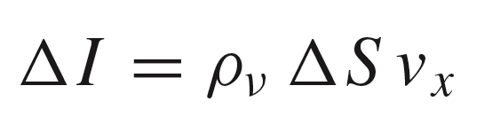
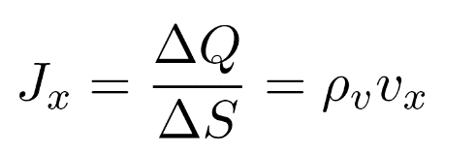
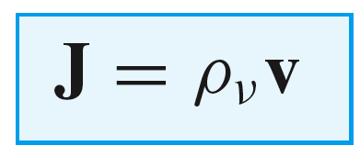
9: Conductors & Dielectrics
Relation of Current to Charge Velocity
So we now have
The current density is then:
So that in general:
Q: How to define the direction of v herein ?
4

Slide 6

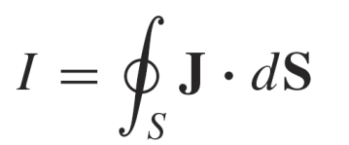
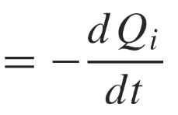
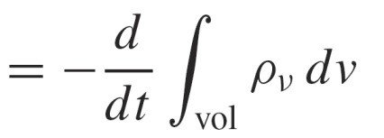

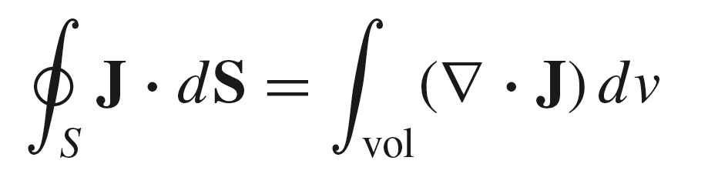
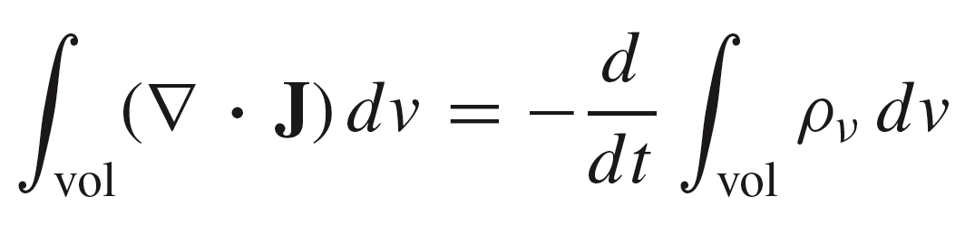
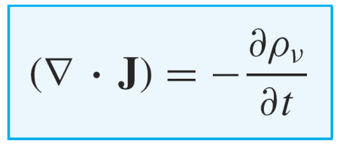
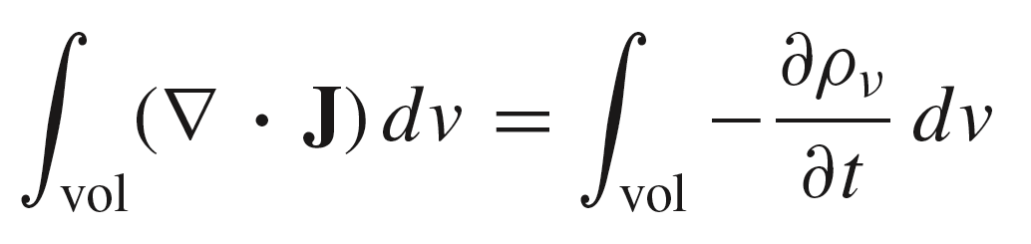
9: Conductors & Dielectrics
Continuity of Current 电流的连续性
Suppose that charge Q_{i} is escaping from a volume through closed surface S, to form current density J. Then the total current is:
Q_{i}(t)
where the minus sign is needed to produce positive outward flux, while the interior charge is decreasing with time.
We now apply the divergence theorem:
The integrands of the last expression
must be equal, leading to the
Equation of Continuity 连续性方程
so that
or
5

Slide 7
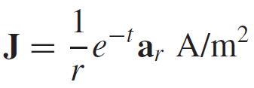


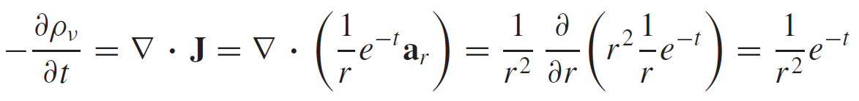
9: Conductors & Dielectrics
Example
Consider a current density that is directed radially outward and decreases exponentially with time,
Selecting an instant of time t = 1 s, we may calculate the total outward current at r = 5 m:
At the same instant, but for a slightly larger radius, r = 6 m, we have
Thus, the total current is larger at r = 6 than it is at r = 5.
6

Slide 8
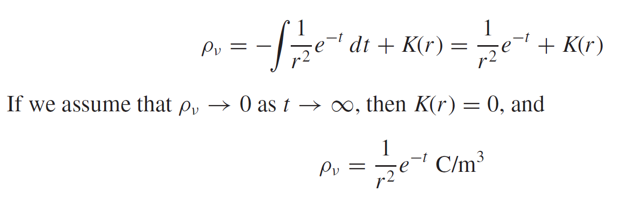
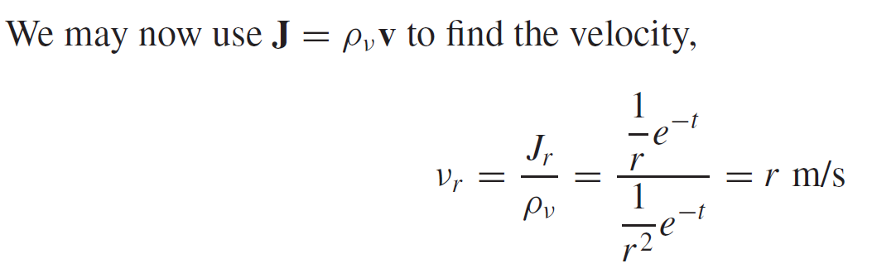
9: Conductors & Dielectrics
Example
7

Slide 9
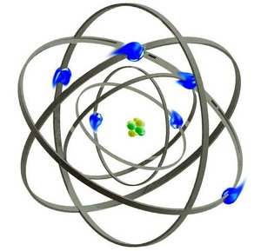
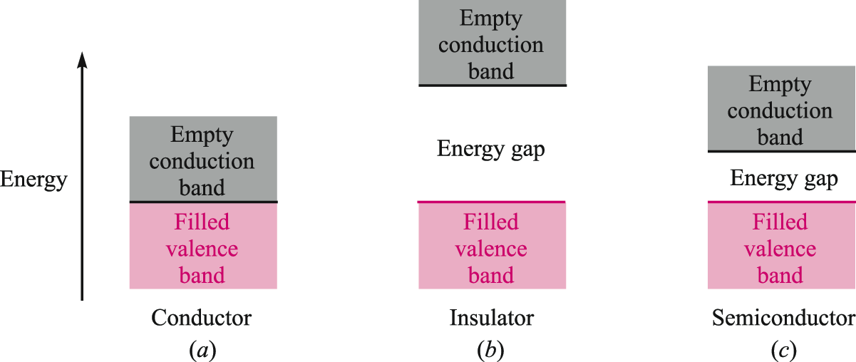
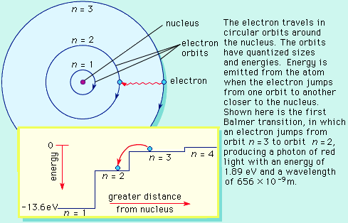
9: Conductors & Dielectrics
Metallic Conductors 金属导体
Energy Band Structure in Three Material Types
Rutherford’s Atomic Model
Bohr Atomic Model
Conductors exhibit no energy gap between valence and conduction bands, so electrons move freely.
Insulators show large energy gaps, requiring large amounts of energy to lift electrons into the conduction band. When this occurs, the dielectric breaks down.
Semiconductors have a relatively small energy gap, so modest amounts of energy (applied through heat, light, or an electric field) may lift electrons from valence to conduction bands.
8

Slide 10
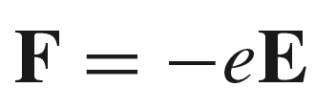
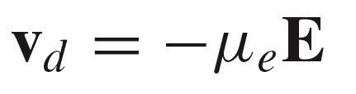

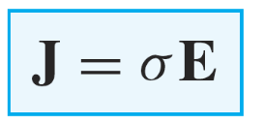
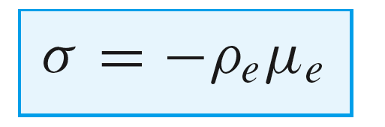
9: Conductors & Dielectrics
Electron Flow in Conductors
Free electrons move under the influence of an electric field. The applied force on an electron of charge Q = -e will be
When forced, the electron accelerates to an equilibrium velocity, known as the drift velocity 漂移速度:
where μ_{e} is the electron mobility漂移率, expressed in units of m²/(Vs). The drift velocity is used to find the current density through:
from which we identify the conductivity 电导率for the case of electron flow :
S/m
9

Slide 11
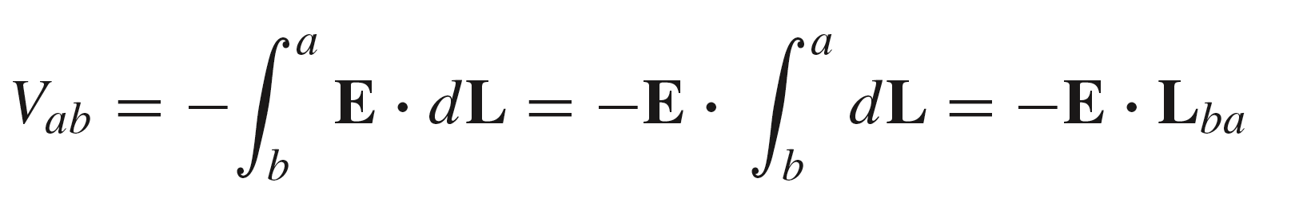

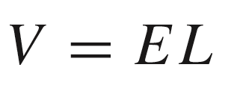
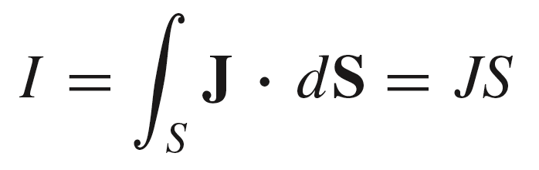
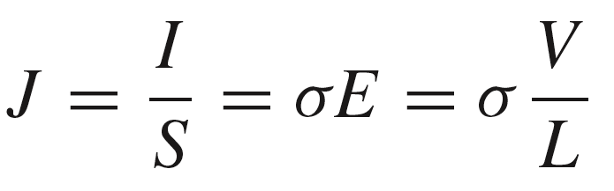
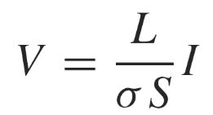
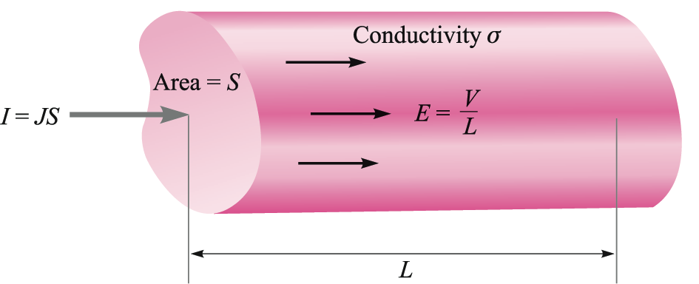
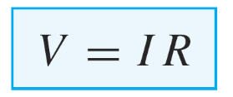
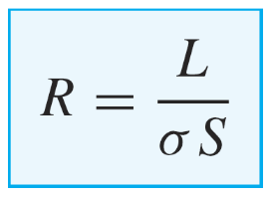
9: Conductors & Dielectrics
Conductance & Resistance 电导& 电阻
Consider the cylindrical conductor shown here, with voltage V applied across the ends. Current flows down the length, and is assumed to be uniformly distributed over the cross-section, S.
First, we can write the voltage and current in the cylinder in terms of field quantities:
Using Ohm’s Law:
We find the resistance of the cylinder:
Unit: ohm
a
b
10

Slide 12
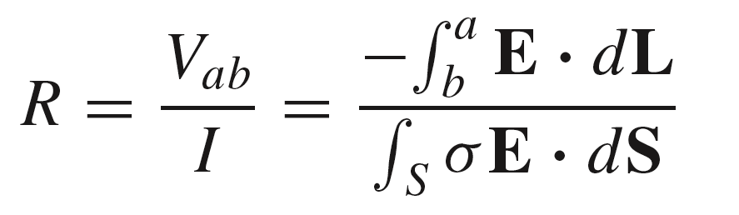
9: Conductors & Dielectrics
Conductance & Resistance 电导&电阻
General Expression for Resistance
a
b
11

Slide 13
9: Conductors & Dielectrics
Electrostatic Properties of Conductors
Consider a conductor, on which excess charge has been placed
+
+
+
+
+
E
+
+
Electric field at the surface
points in the normal direction
+
+
+
solid conductor
+
ρ_{s}
+
E = 0 inside
+
+
+
+
+
+
+
+
+
1. Charge can exist only on the surface as a surface charge density, ρ_{s} -- not in the interior.
2. Electric field cannot exist in the interior, nor can it possess a tangential component at the surface.
3. It follows from condition 2 that the surface of a conductor is an equipotential.
12

Slide 14
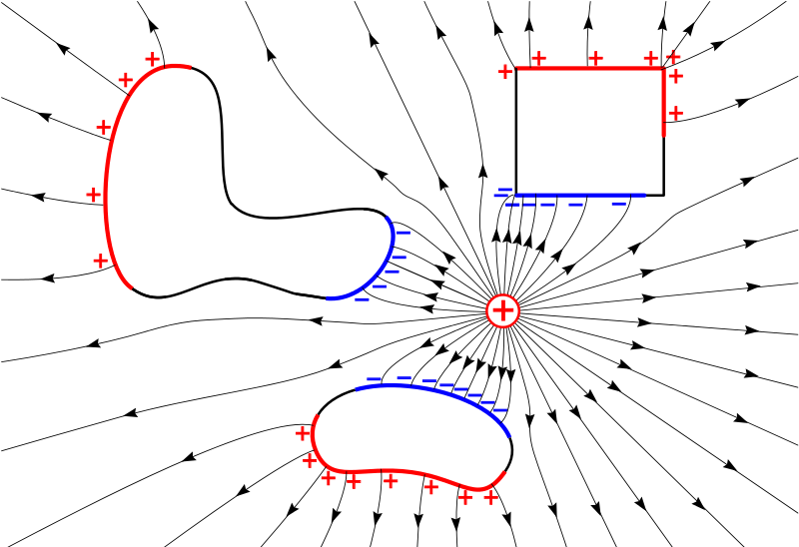
9: Conductors & Dielectrics
Electrostatic Properties of Conductors
+
+
+
+
+
E
+
+
+
+
+
solid conductor
+
ρ_{s}
+
E = 0 inside
+
+
+
+
+
+
+
+
+
1. Charge can exist only on the surface as a surface charge density, ρ_{s} -- not in the interior.
2. Electric field cannot exist in the interior, nor can it possess a tangential component at the surface.
3. It follows from condition 2 that the surface of a conductor is an equipotential.
13

Slide 15
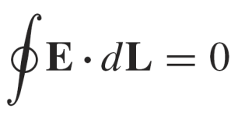
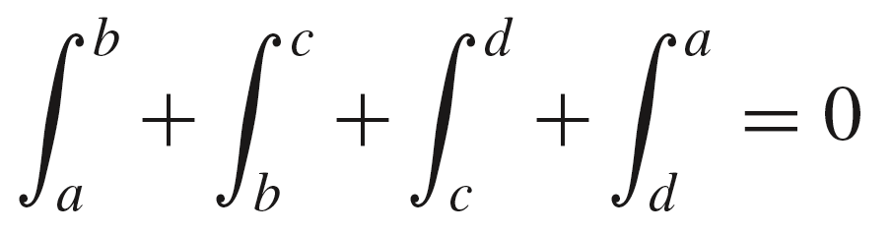
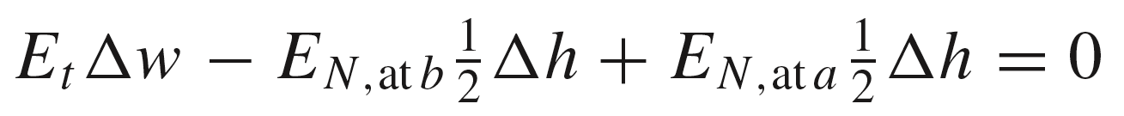
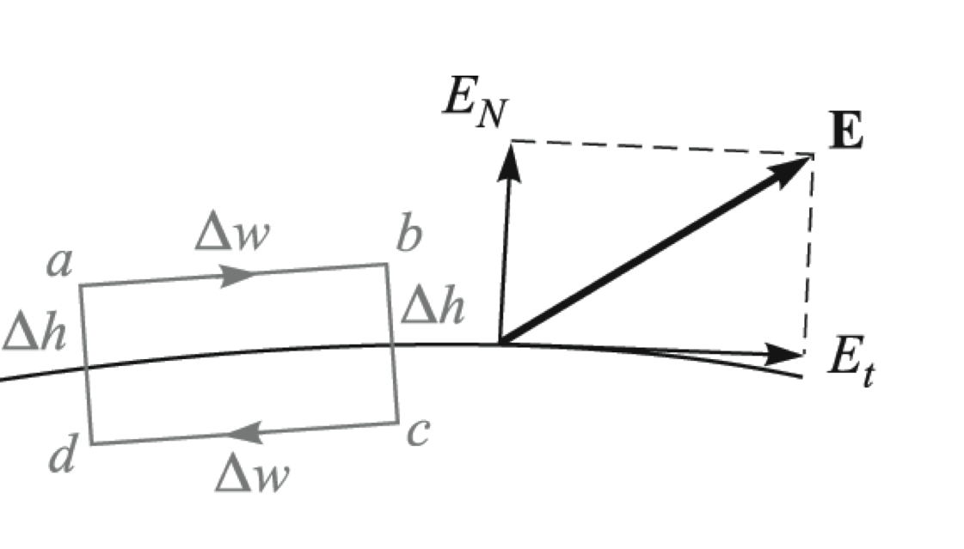
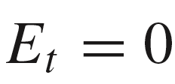
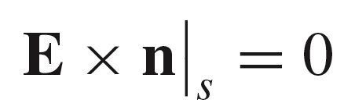
9: Conductors & Dielectrics
Boundary Condition
Over the rectangular integration path, we use
or
To find:
These become negligible as Δh approaches zero.
dielectric
Therefore
n
More formally:
conductor
14

Slide 16
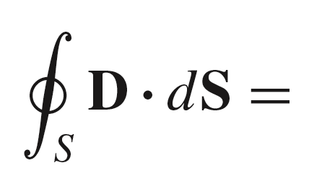





9: Conductors & Dielectrics
Boundary Condition
Gauss’ Law is applied to the cylindrical surface shown below:
This reduces to:
as Δh approaches zero
dielectric
Therefore
n
More formally:
ρ_{s}
conductor
15

Slide 17

9: Conductors & Dielectrics
Summary
Tangential E is zero
At the surface:
Normal D is equal to the surface charge density
16

Slide 18

9: Conductors & Dielectrics
Example
17

Slide 19


9: Conductors & Dielectrics
Example
17

Slide 20


9: Conductors & Dielectrics
Example
18

Slide 21








9: Conductors & Dielectrics
Example
19

